Slide 1


Contained Availability Groups
Next level of SQL-Server High Availability
André Wittmer
Datamonster.io
Regional Group Thüringen

Slide 2

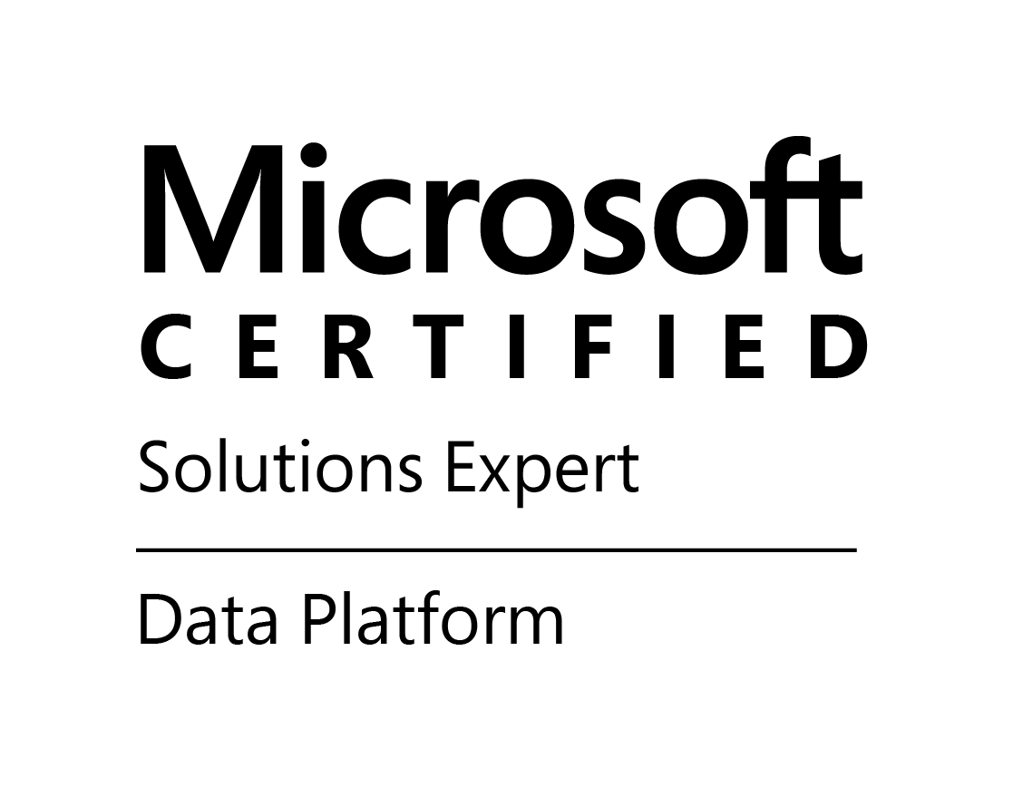
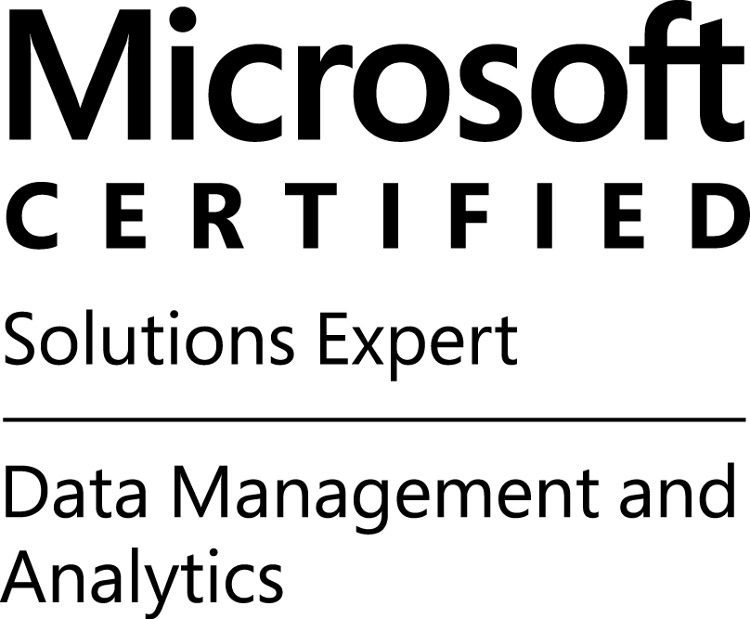
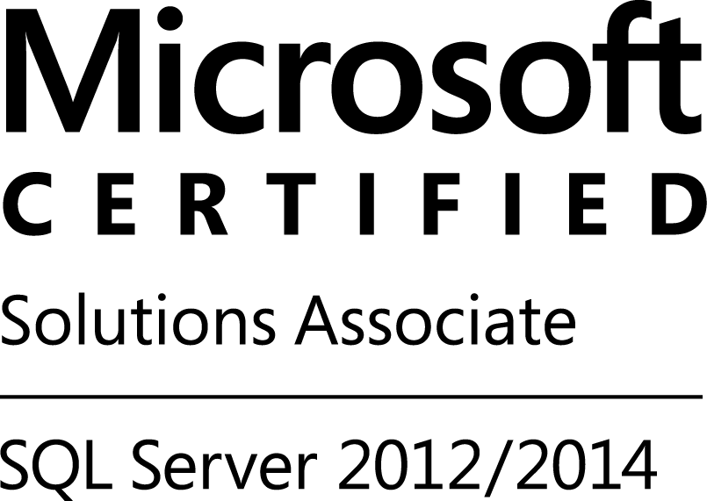
André Wittmer Wittmer IT-Services
I have been working as a freelance IT consultant since 2002 and have specialized in SQL Server in 2006.
I have worked with SQL-Server since Version 7.0 I'm focused on deployment and automated operation of in large environments to build high available and secure solutions.
I have been MCSE certified since 2014 and worked partially for Microsoft as Dedicated Support Engineer.
E-Mail: a.wittmer@wittmer-it.de
Xing: https://www.xing.com/profile/Andre_Wittmer
LinkedIn: https://www.linkedin.com/in/andre-wittmer-115b22137/

Slide 3
What is an Availability Group?
Listener ag1
SQL-Server 1
(primary replica)
Logins
Certificate and Keys
Credentials
Linked Server
SQL-Server 2
(secondary replica)
Logins
Certificate and Keys
Credentials
Linked Server
master
master
SQL Agent Jobs
History Tables
SQL Agent Jobs
History Tables
msdb
msdb
model
model
tempdb
tempdb
ag1
ag1
user database 1
synchronisation
user database 1
user database 1
user database 1

Slide 4


Availability Groups Pro and Con
Whats good?
What bad?
Grouping of databases
Up to 8 secondary replicas
Readable secondaries
Synchronisation options per replica
Listener point to primary instance only
Manual sync of system objects
Complex job controling
Complex handling with multiple AGs

Slide 5
Contained system databases
Logins
Certificate and Keys
Credentials
Linked Server
Listener ag1
master
SQL Agent Jobs
History Tables
Each contained availability group use it own system databases:
[contained AG]_master mapped as master database
[contained_AG]_msdb mapped as msdb database.
S
msdb
S
SQL-Server 1
(primary replica)
SQL-Server 2
(secondary replica)
master
tempdb
master
msdb
user database
msdb
model
model
tempdb
tempdb
Contained Availability Group
Contained Availability Group
ag1_master
ag1_master
ag1_msdb
synchronisation
ag1_msdb
user database
user database

Slide 6
Contained Availability Groups: Whats new?
Dedicated system databases master and msdb
Dedicated System Objects like logins, credentials, certificates
Dedicated SQL Server Agent configuration
Permission restricted to contained AG, but not always!
Connection is restricted to CAG

Slide 7
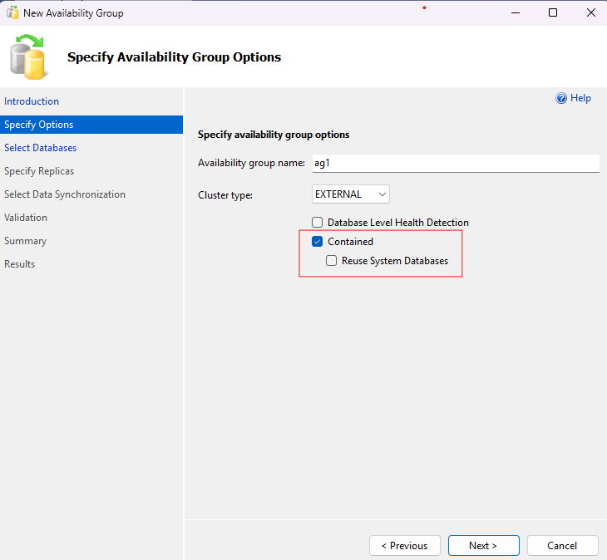
How to create a Contained AG?
Activate Contained in New AG Wizard
Contained System datadases can be reused (If they follow the correct name schema)
All local sysadmins are copied in new contained AG
Notes:
Demo: instance and showing databases

Slide 8
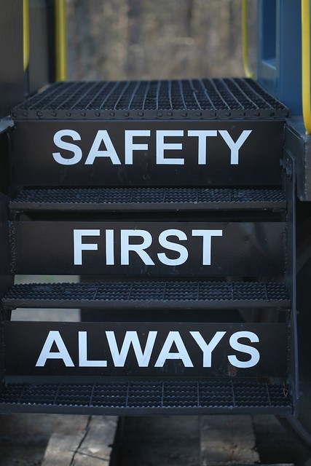
Sysadmin in contained AG
Sysadmin have full access on any other database on primary instance, except local master and msdb
Local master and msdb can‘t access because of the name mapping
Sysadmin can grant permission on databases outside of the AG to users exists only in CAG
Any sysadmin copied to CAG during creation
Sysadmin accounts can never be restricted and should be avoid!
"This photo" by Unknown author is licensed according to CC BY-SA

Slide 9
Contained System Databases – Database Options
Contained system databases are readable on seconadries
database options differ to local system databases
master
Page verify option is none
DB chaining is off
Recovery model FULL
msdb
Recovery model FULL
Cross database ownership chaning is off
Snapshot isolation is off
Trustworthy is off
Mixed page allocation is off

Slide 10
Feature support
SQL Agent Jobs
Jobs can start on primary replica only
Jobs and history stored in contained msdb
Linked Server
Transparent Database Encryption
Certificates can stored in local or contained master
Backup started inside contained AG
Backup history stored in contained msdb
Change Data Capture
Log Shipping (Primary Role only)
Database driver must install on any node
Distributed Availability Groups
starting with SQL-Server 2025

Slide 11
SQL-Server Agent
Contained AG
Each CAG has it‘s own SQL-Server Agent
Jobs are running on primary replica only
Jobs can‘t start on secondary replica
Job history ist stored in contained msdb
SQL-Server Agent
Instance 1
(primary replica)
Instance 2
(secondary replica)
SQL-Server Agent
SQL-Server Agent

Slide 12
Backup Databases
Instance
BACKUP DATABASE [demo_db]
Depending on which endpoint the backup triggered, the backup history is written to the msdb on instance level or on the contained msdb.
master
Backup History
msdb
model
tempdb
BACKUP DATABASE [demo_db]
When the backup triggered inside the AG, the backup history stored completely inside the contained msdb.
Contained AG
ag1_master
Backup History
ag1_msdb
demo_db
RESTORE must be done on instance level, same with CREATE database!

Slide 13

Desaster Recovery
No different between contained system databases and user databases during restore
Contained AG can recreate using parameter REUSE_SYSTEM_DATABASES

Slide 14
Transparent Data Encryption
Instance
Windows:
Data Protection API
master db
Service Master Key
OR
Linux/Container:
Machine Key
Database Master Key
Certificate
TDE certificate can be stored in both master databases:
All instance level master databases
Contained master db
user db
Database Encryption Key

Slide 15
Service Master Key Encryption
Every master database has it‘s own SMK
SMK of contained master database is encrypted by the Windows Service Account (DPAPI) / Linux Machine Key of the node which create the Contained AG
Server 1:
DPAPI / Machine Key
Server 1:
DPAPI / Machine Key
Use same Service Account or Machine Key
Instance 1
Contained AG1
Instance 2
master
AG1_master
master
Service Master Key
Service Master Key
Service Master Key

Slide 16
Machine Key on Linux
Stored in /var/opt/mssql/secrets/machine-key
12 Byte Header + 32 Byte Random Garbage
Must be configured before the first start of the instance
Service Master Key can‘t be re-encrypt with a new Machine Key
Hex:
010000000000000000000000859D8E1E2853CB8D625A88B5C9691749F45610FAE1A8523F6431A61CEE65923B
12 Byte Header
32 Byte Random Key

Slide 17
Dynamic View Changes for CAG
sys.availability_groups
is_contained
sys.dm_exec_sessions
contained_availability_group_id

Slide 18
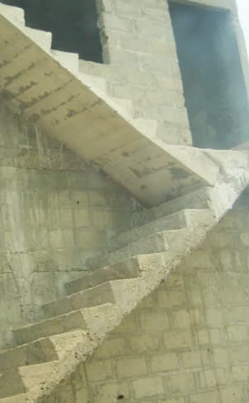
Whats missing or not supported in CAG?
CREATE DATABASE is not allowed
RESTORE DATABASES is not allowed
Server configuration on instance level only
TDE Certificate in contained master is usable aslong database is joined in AG
SQL Agent Job execution on secondary replica is not supported
Backup Encryption certificate used from instance only
23.09.2025
Datamonster.io RGV Stuttgart
18

Slide 19
Final Insights!
Check if you are connected on the right Endpoint!
Be always carefull to grant sysadmin permissons!
Use the same service account / machine key on all nodes!
Contained Availability Groups are not a security boundary!

Slide 20

Any Questions?

